Slide 1


Minor Project
Title:
Hybrid encryption compression algorithm.
Presented by:
Mohit Bishesh, R2142201858, CSE CCVT
Yuvraj Singh Pundir, R2142201827, CSE CCVT
Anant Garg, R2142201709, CSE CCVT
Shiv Pratap Pundir, R2142201668, CSE CCVT
Guided by:
Mr. Sandeep Pratap Singh
Assistant Professor (SS)
Systemics Cluster
School of Computer Science

Slide 2
Content
Introduction
Problem Statement
Motivation
Objectives
Tech Stack
Methodology
Implementation
SWOT Analysis
Application of the Project
PERT Chart
Objectives Covered
References

Slide 3
1. Introduction
We cannot compromise with security and size of data while communication.
Encryption is the method by which information is converted into secret code that hides the information's true meaning.
Cryptography plays an important role in maintaining data security as it is an encryption technique that converts plaintext to ciphertext with certain algorithms.
AES is a very strong cryptographic algorithm, making it the security standard of the National Institute of Standards and Technology.
Data compression is a method in which the logical size of a file is reduced to save disk space for easier and faster transmission over a network or the Internet.
But in some studies, it was stated that the use of AES has side effects on file size, so Huffman encoding is used for lossless compression of data, which ultimately increases the security and efficiency of data transfer.

Slide 4
2. Problem Statement
Advanced Encryption Standard is a widely used and recognized encryption algorithm.
Although the algorithm provides strong and reliable encryption, it does so on the cost of making the file size slightly larger. Therefore, there is a need to negate this drawback.
Huffman encoding can be coupled with AES to produce compressed lossless encrypted files without compromising security.

Slide 5
3. Motivation
The project aims to have the following features :
The project ultimately aims to reduces the size and increased the security of the encrypted data.
Reduces cost of transmission.
Lossless compression ensures data integrity.
Add additional layer of security to AES using Huffman encoding.

Slide 6
4. Objectives
To implement AES and DES to generate ciphertext from plaintext.
To compare file size of ciphertexts generated by AES and DES respectively.
To compress plain text using Huffman Encoding and then perform encryption.
To compare the size of compressed ciphertext with normal ciphertext.

Slide 7
5. Technology Stack
Development
Backend – C++
File handling
Algorithms
AES (Advanced encryption standard).
Huffman encoding.
DES ( Data encryption standard).
Data Structures
Priority queue (for building Huffman tree).
Minimum heap (to implement functionality of priority queue).
Array.
Linked list.

Slide 8
6. Methodology
Input plaintext will be taken.
Generating of cipher text of input string using AES or DES algorithm.
File size of generated ciphertext will be noted.
Compression of input plaintext using Huffman encoding.
Encryption of compressed input plaintext.
Calculation of compression factor for each ciphertext generated with respect to the encryption technique used.

Slide 9
6. Methodology (contd.)
Input plaintext will be taken.
Generating of cipher text of input string using AES or DES algorithm.
Calculation of compression factor for each ciphertext generated with respect to the encryption technique used.
File size of generated ciphertext will be noted.
Encryption of compressed input plaintext.
Compression of input plaintext using Huffman encoding.
Fig.1 Methodology Chart

Slide 10
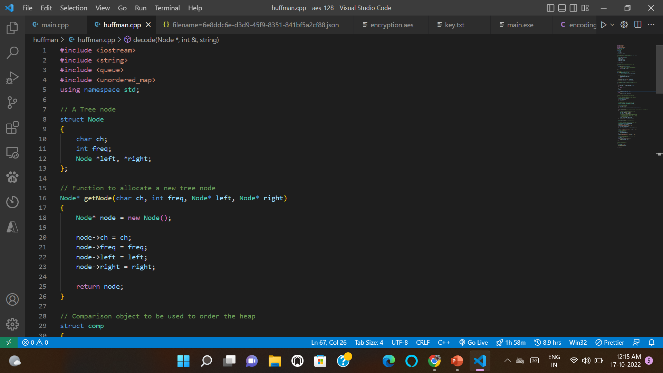
7. Implementation
1. Code to implement Huffman.
Fig→ 7.1.1

Slide 11
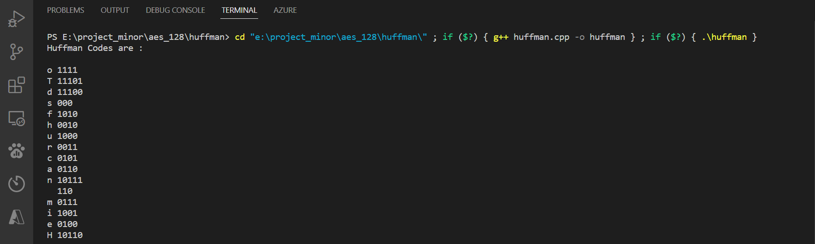
2. The generated Huffman code for input string “This is our Huffman code” is shown below.
Fig→ 7.1.2

Slide 12
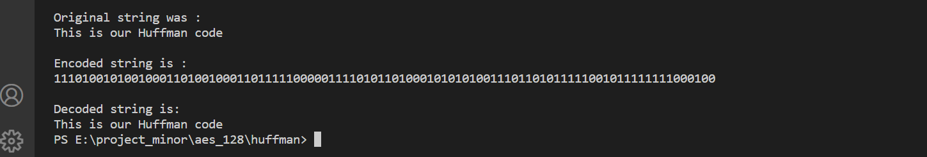
3. The encoded in binary and decoded string is shown below
Fig→ 7.1.3

Slide 13
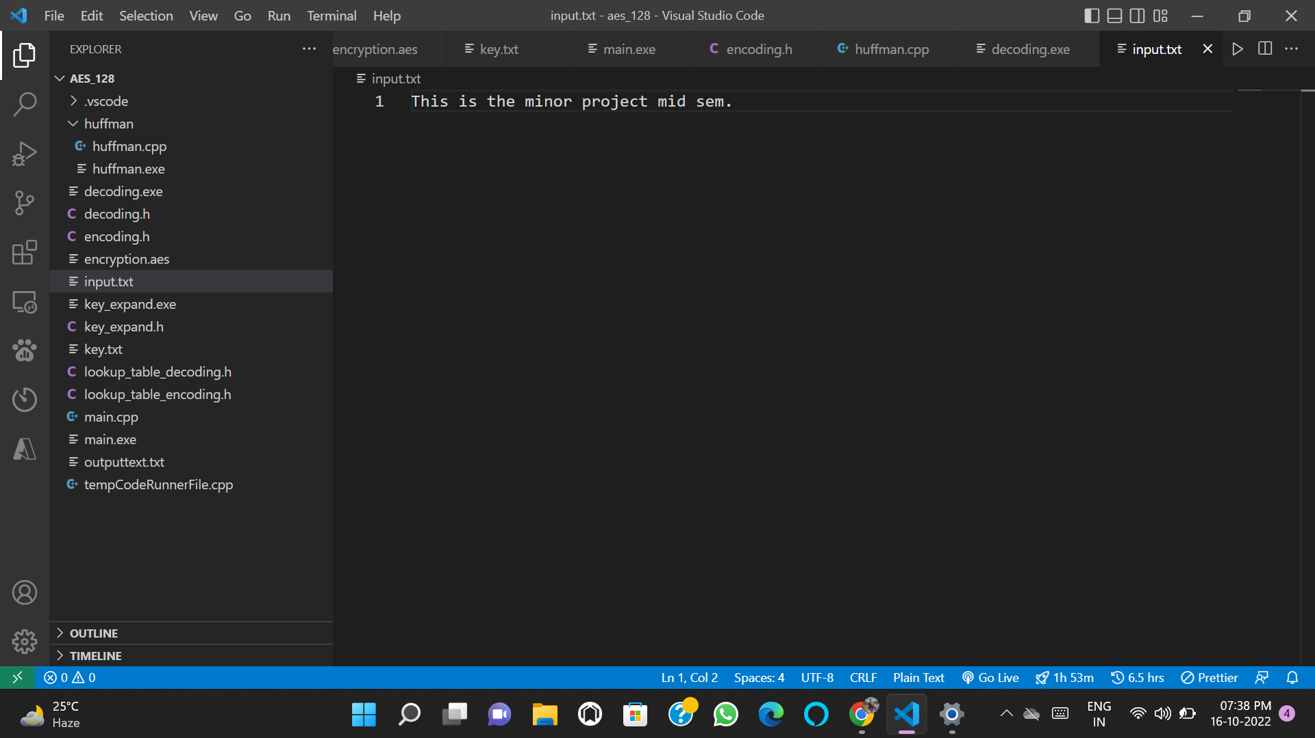
Advanced Encryption Standard
1) Input plaintext stored in 'input.txt'.
Fig→ 7.2.1

Slide 14
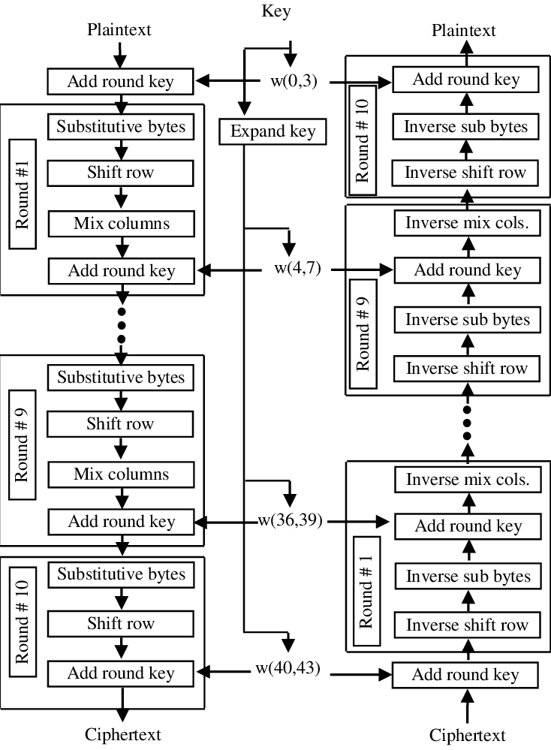
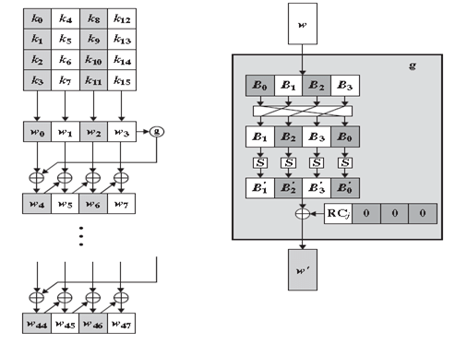
https://img.brainkart.com/imagebk9/HbLkjBr.jpg

Slide 15
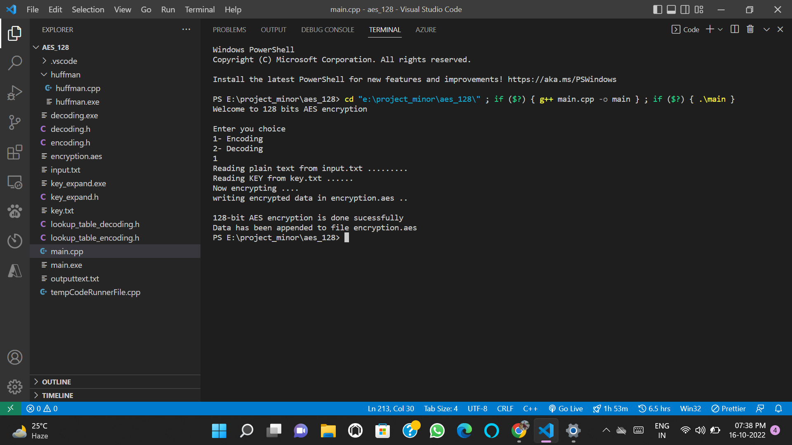
2) Running main.cpp . Select option 1 for encryption.
Fig→ 7.2.2

Slide 16
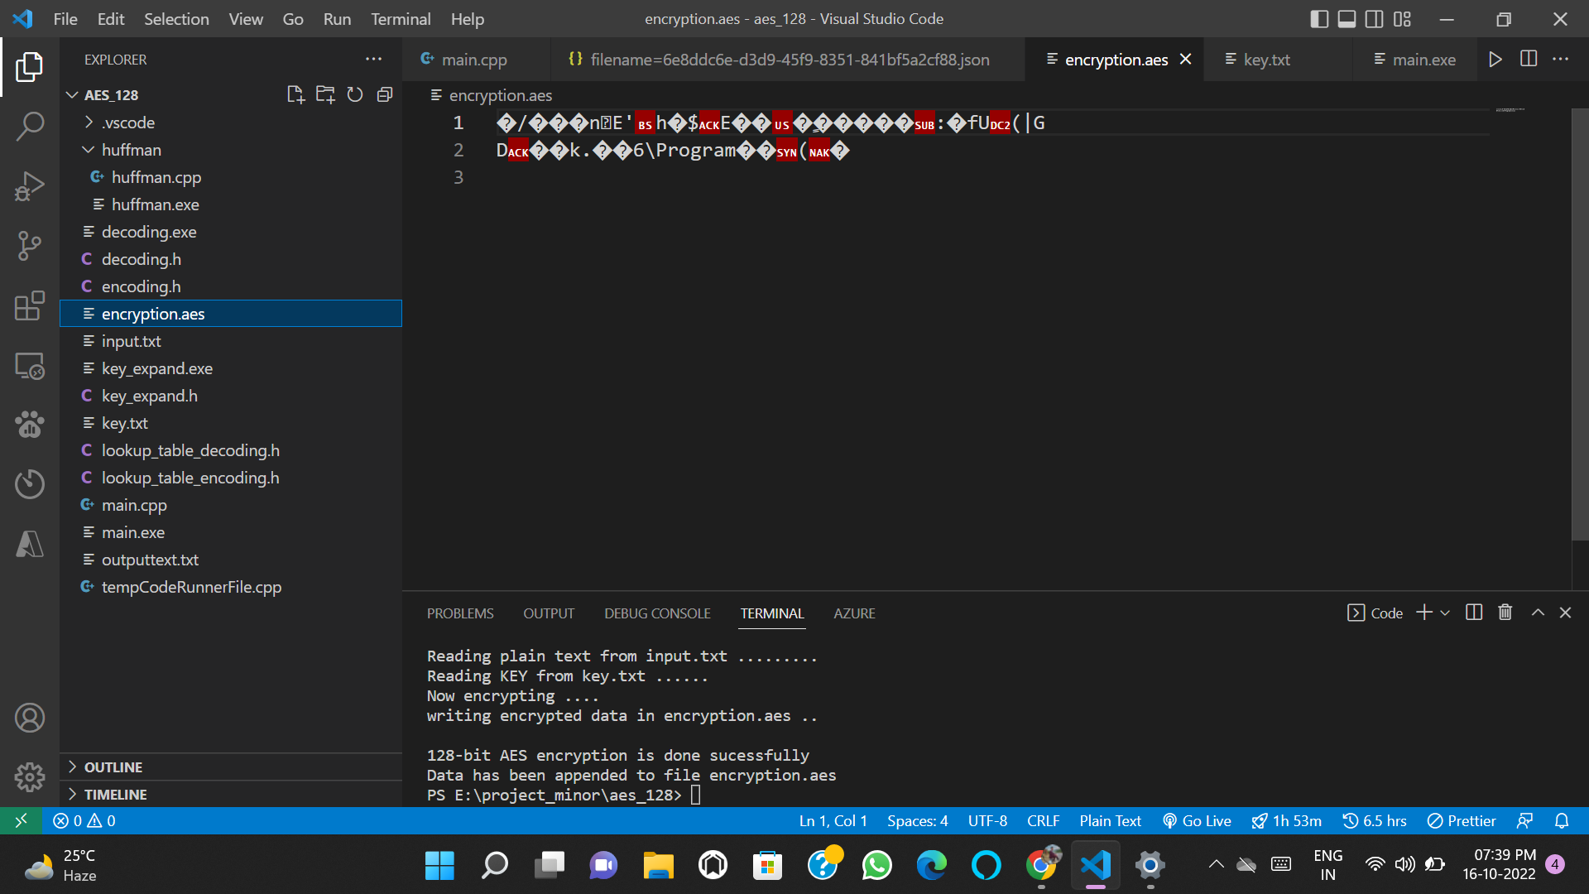
3) Encrypted text stored in 'encryption.aes'.
Fig→ 7.2.3

Slide 17
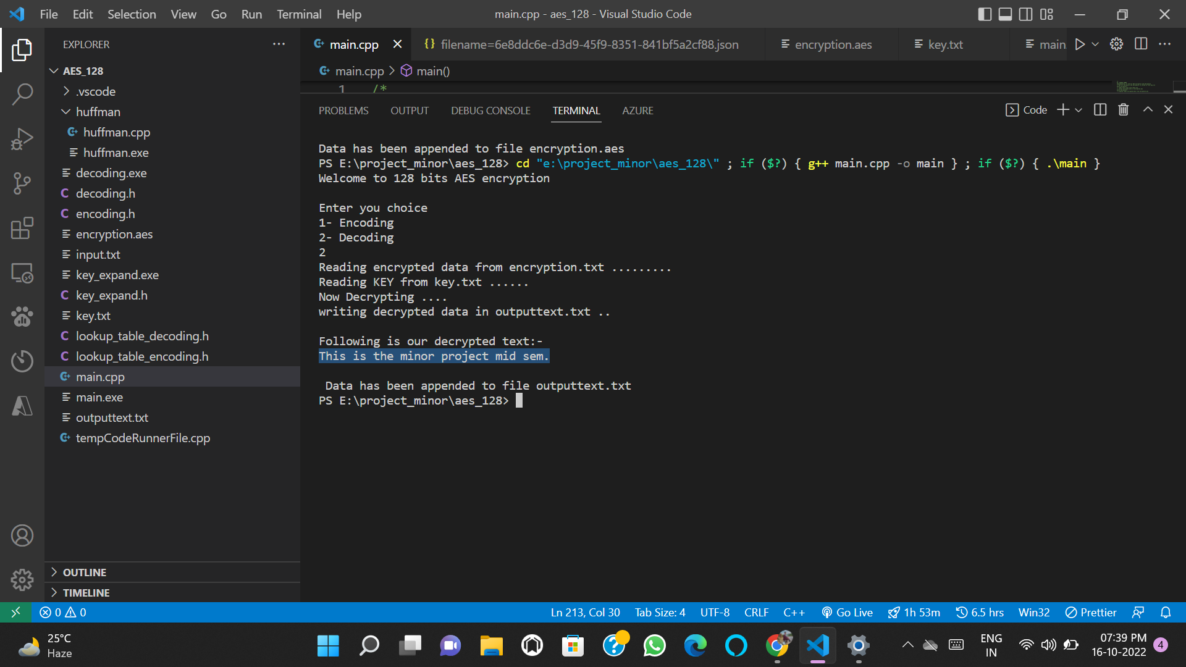
4) Running main.cpp . Select option 2 for decryption.
Fig→ 7.2.4

Slide 18
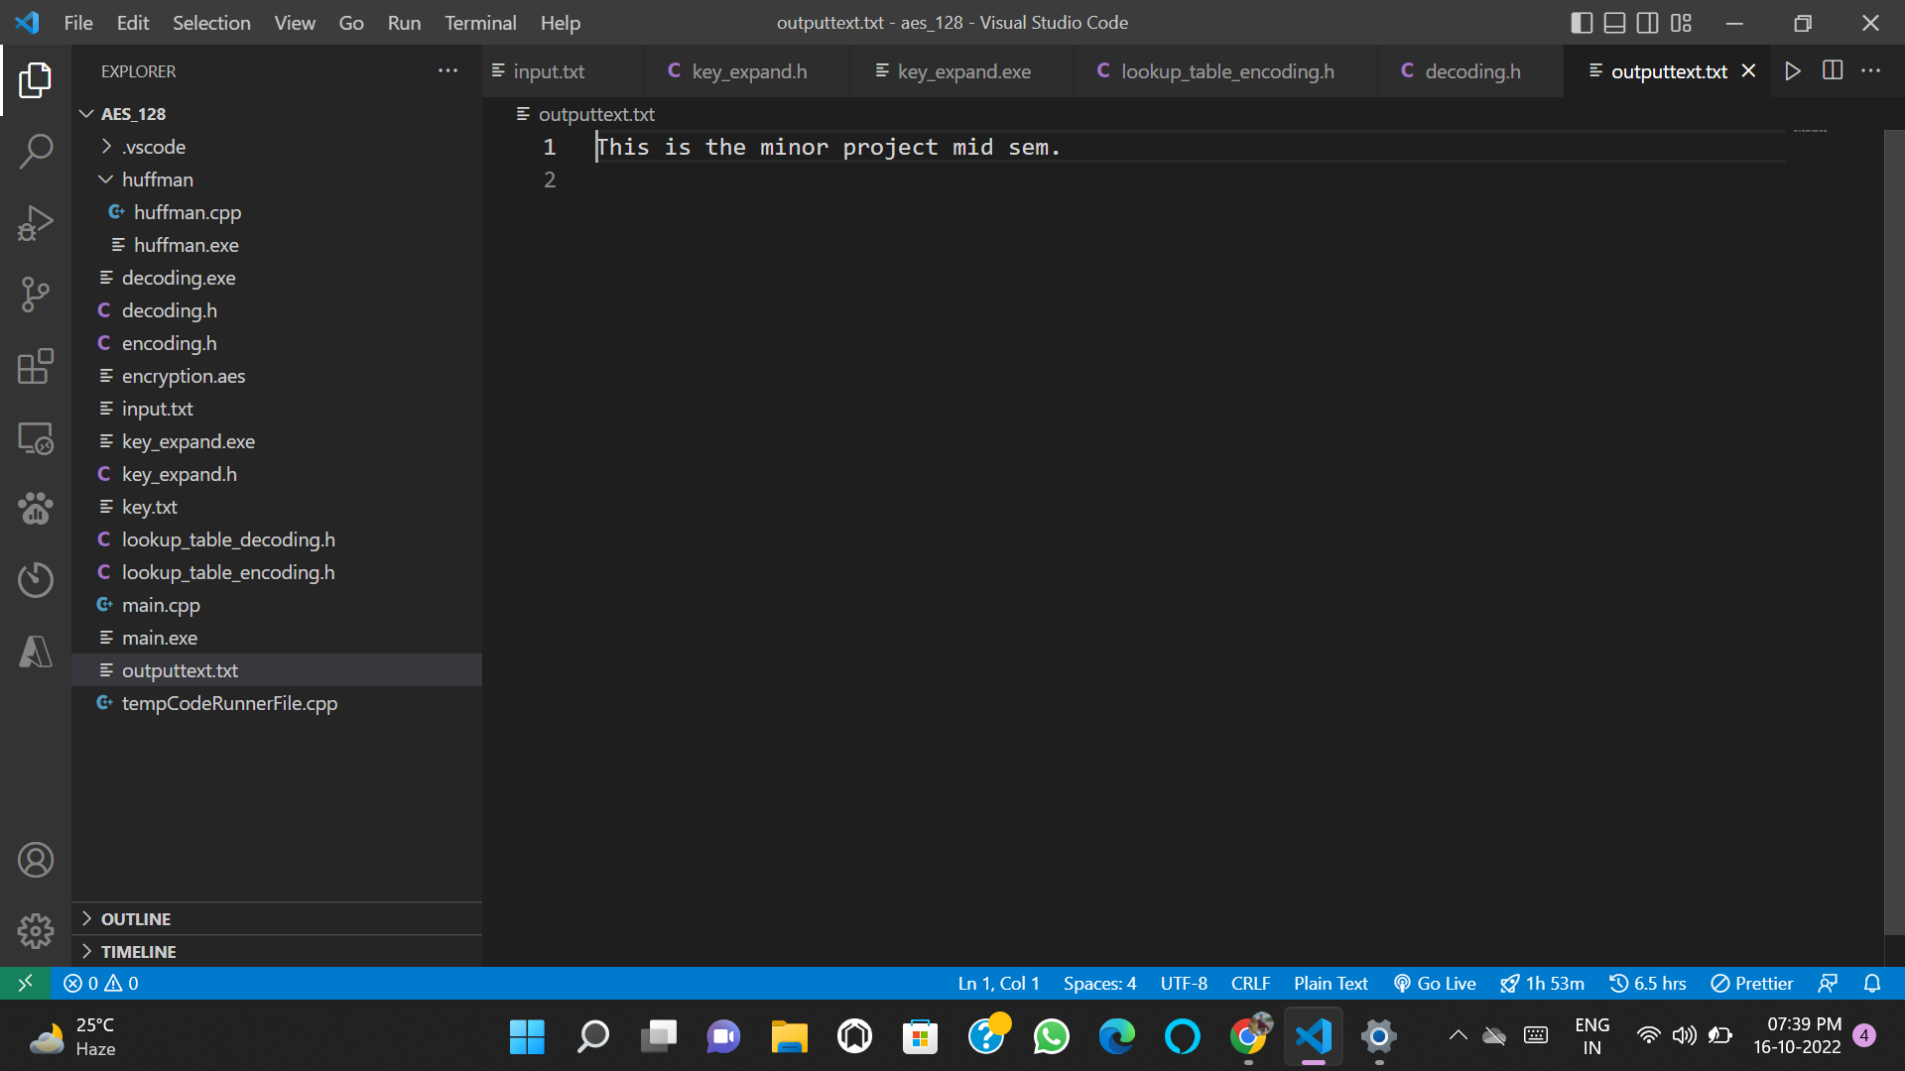
5) Decrypted text stored in 'outputtext.txt'.
Fig→ 7.2.5

Slide 19
8. SWOT
Strength :
High encryption.
Reduces cost of transmission.
Reduces the bandwidth requirement.
Weakness :
Cost of implementing algorithm is required.
Time to implementing algorithm is required.
Opportunity :
Can be implemented in chat based server for high security and low cost data transfer.
Threat :
Some researches are ongoing to achieve this objective more efficiently.

Slide 20
9. Application.
To minimise the band width usage for any data communication.
Reduces cost of transmission.
To provide better end-to-end encryption for users.
To generate lossless encrypted zip files.

Slide 21
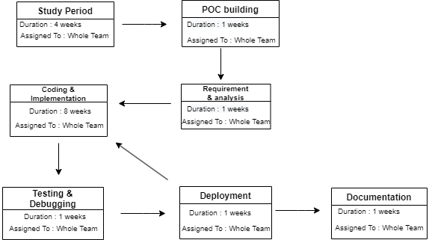
10. PERT Chart
Program Evaluation Review Technique Chart

Slide 22
11. Objectives Covered
Objectives | Status
Ideation | Completed
Learning the technologies used | Completed
Building a POC | Completed
Implementation | Completed
Documentation | Completed

Slide 23
12. References
[1] Hybrid AES-Huffman Coding for Secure Lossless Transmission.
https://ieeexplore.ieee.org/document/8985899
[2] DES and AES performance evaluation.
https://ieeexplore.ieee.org/abstract/document/7148500
[3] https://ieeexplore.ieee.org/document/7845058

Slide 24
Thank You

